Slide 1

Data-Intensive Text Processing
with MapReduce
Tutorial at the 32nd Annual International ACM SIGIR Conference on Research and Development in Information Retrieval (SIGIR 2009)
Jimmy Lin
The iSchool
University of Maryland
Sunday, July 19, 2009
This work is licensed under a Creative Commons Attribution-Noncommercial-Share Alike 3.0 United States
See http://creativecommons.org/licenses/by-nc-sa/3.0/us/ for details. PageRank slides adapted from slides by Christophe Bisciglia, Aaron Kimball, & Sierra Michels-Slettvet, Google Distributed Computing Seminar, 2007 (licensed under Creation Commons Attribution 3.0 License)

Slide 2
Who am I?

Slide 3
Why big data?
Information retrieval is fundamentally:
  Experimental and iterative
  Concerned with solving real-world problems
“Big data” is a fact of the real world
Relevance of academic IR research hinges on:
  The extent to which we can tackle real-world problems
  The extent to which our experiments reflect reality

Slide 4

How much data?
Google processes 20 PB a day (2008)
Wayback Machine has 3 PB + 100 TB/month (3/2009)
Facebook has 2.5 PB of user data + 15 TB/day (4/2009)
eBay has 6.5 PB of user data + 50 TB/day (5/2009)
CERN’s LHC will generate 15 PB a year (??)
640K ought to be enough for anybody.

Slide 5
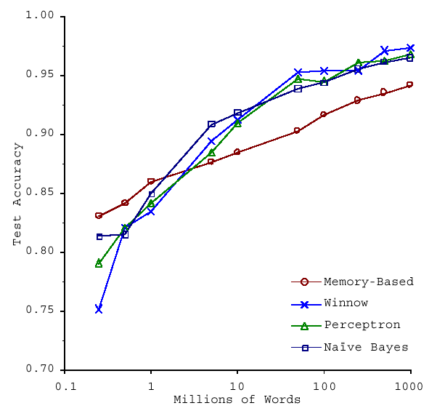
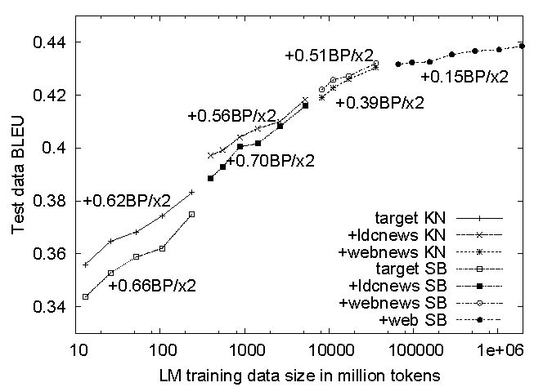
No data like more data!
s/knowledge/data/g;
How do we get here if we’re not Google?
(Banko and Brill, ACL 2001)
(Brants et al., EMNLP 2007)

Slide 6
Academia vs. Industry
“Big data” is a fact of life
Resource gap between academia and industry
  Access to computing resources
  Access to data
This is changing:
  Commoditization of data-intensive cluster computing
  Availability of large datasets for researchers

Slide 7
MapReduce
e.g., Amazon Web Services
cheap commodity clusters
(or utility computing)
+ simple distributed programming models
+ availability of large datasets
= data-intensive IR research for the masses!
ClueWeb09

Slide 8
ClueWeb09
NSF-funded project, led by Jamie Callan (CMU/LTI)
It’s big!
  1 billion web pages crawled in Jan./Feb. 2009
  10 languages, 500 million pages in English
  5 TB compressed, 25 uncompressed
It’s available!
  Available to the research community
  Test collection coming (TREC 2009)

Slide 9
Ivory and SMRF
Collaboration between:
  University of Maryland
  Yahoo! Research
Reference implementation for a Web-scale IR toolkit
  Designed around Hadoop from the ground up
  Written specifically for the ClueWeb09 collection
  Implements some of the algorithms described in this tutorial
  Features SMRF query engine based on Markov Random Fields
Open source
  Initial release available now!

Slide 10
Cloud⁹
Set of libraries originally developed for teaching MapReduce at the University of Maryland
  Demos, exercises, etc.
“Eat you own dog food”
  Actively used for a variety of research projects

Slide 11
Topics: Morning Session
Why is this different?
Introduction to MapReduce
Graph algorithms
MapReduce algorithm design
Indexing and retrieval
Case study: statistical machine translation
Case study: DNA sequence alignment
Concluding thoughts

Slide 12
Topics: Afternoon Session
Hadoop “Hello World”
Running Hadoop in “standalone” mode
Running Hadoop in distributed mode
Running Hadoop on EC2
Hadoop “nuts and bolts”
Hadoop ecosystem tour
Exercises and “office hours”

Slide 13
Why is this different?
Introduction to MapReduce
Graph algorithms
MapReduce algorithm design
Indexing and retrieval
Case study: statistical machine translation
Case study: DNA sequence alignment
Concluding thoughts

Slide 14
Divide and Conquer
“Work”
Partition
w₁
w₂
w₃
“worker”
“worker”
“worker”
r₁
r₂
r₃
Combine
“Result”

Slide 15
It’s a bit more complex…
Fundamental issues
scheduling, data distribution, synchronization, inter-process communication, robustness, fault tolerance, …
Different programming models
Message Passing
Shared Memory
Memory
P₁
P₂
P₃
P₄
P₅
P₁
P₂
P₃
P₄
P₅
Architectural issues
Flynn’s taxonomy (SIMD, MIMD, etc.),
network typology, bisection bandwidth
UMA vs. NUMA, cache coherence
Different programming constructs
mutexes, conditional variables, barriers, …
masters/slaves, producers/consumers, work queues, …
Common problems
livelock, deadlock, data starvation, priority inversion…
dining philosophers, sleeping barbers, cigarette smokers, …
The reality: programmer shoulders the burden of managing concurrency…

Slide 16
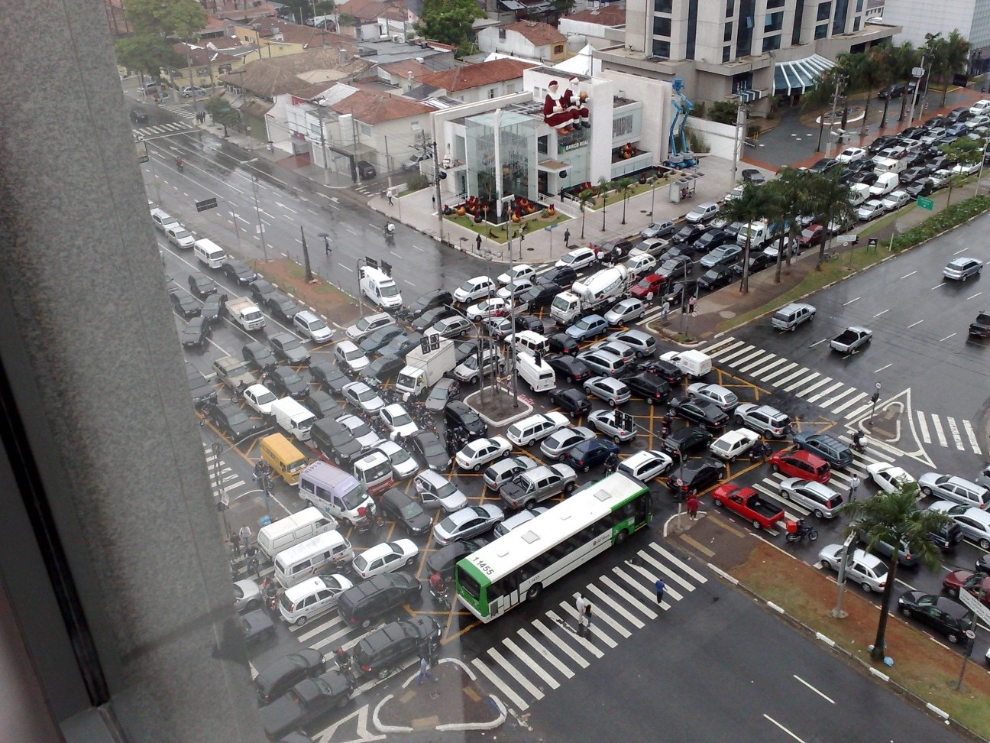
Source: Ricardo Guimarães Herrmann

Slide 17
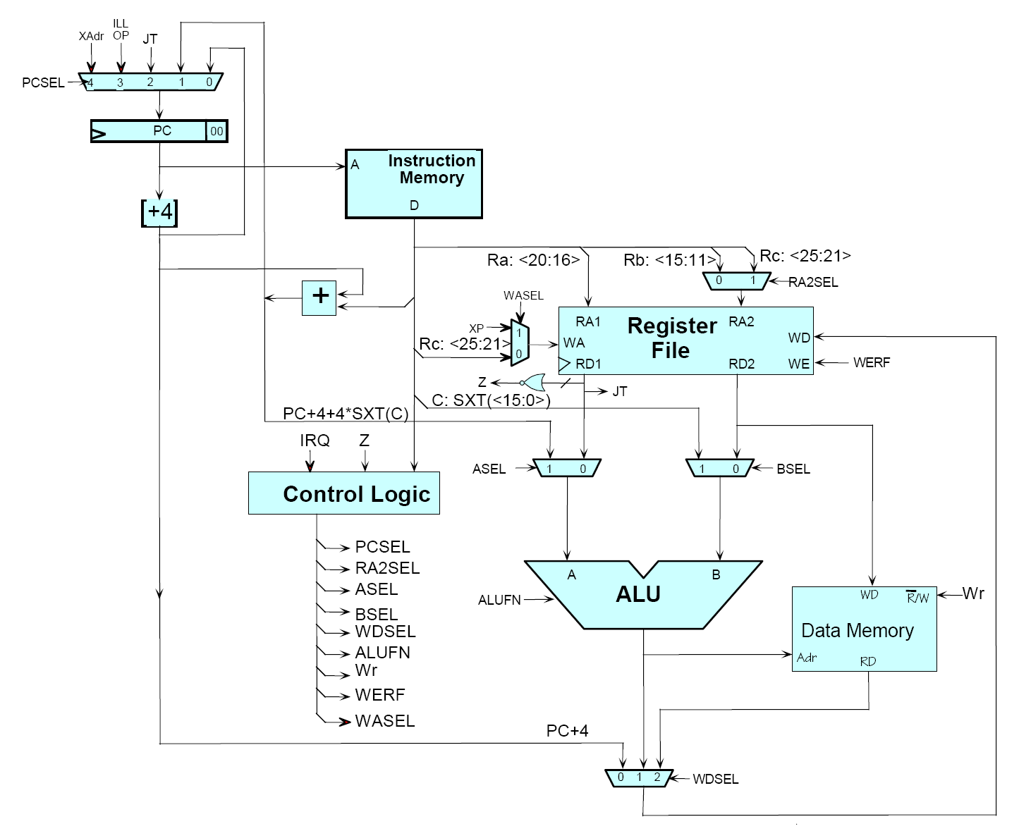
Source: MIT Open Courseware

Slide 18

Source: MIT Open Courseware

Slide 19
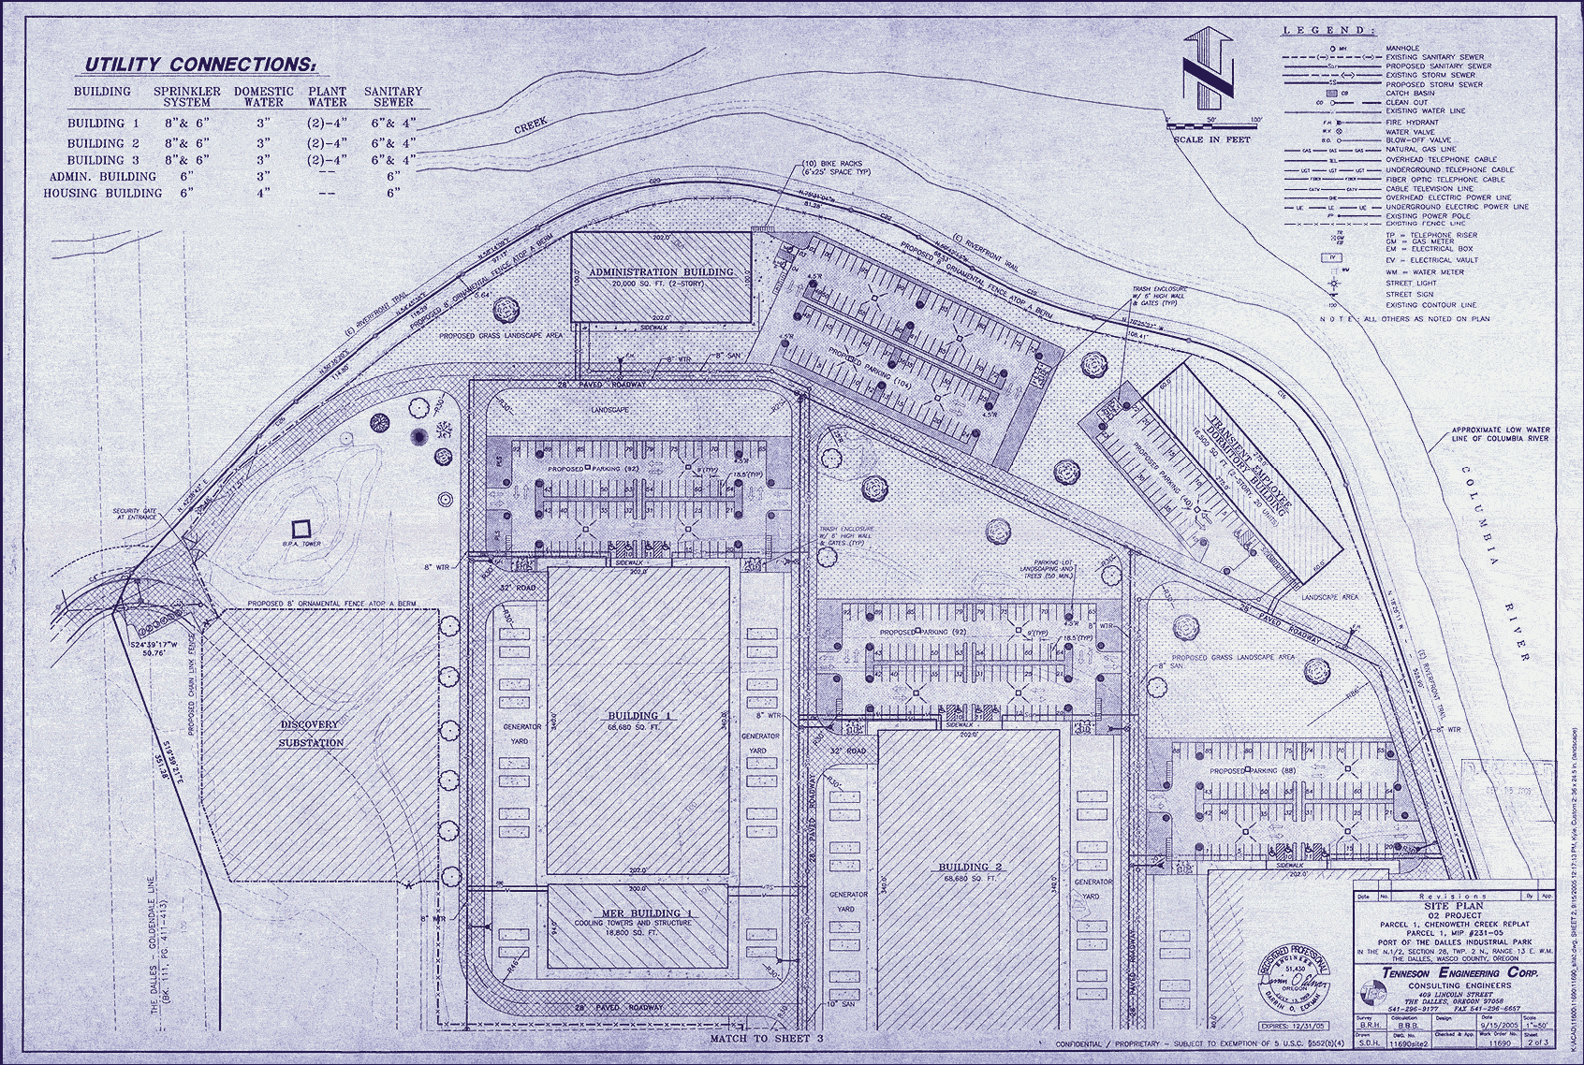
Source: Harper’s (Feb, 2008)

Slide 20
Introduction to MapReduce
Why is this different?
Graph algorithms
MapReduce algorithm design
Indexing and retrieval
Case study: statistical machine translation
Case study: DNA sequence alignment
Concluding thoughts

Slide 21
Typical Large-Data Problem
Iterate over a large number of records
Extract something of interest from each
Shuffle and sort intermediate results
Aggregate intermediate results
Generate final output
Map
Reduce
Key idea: provide a functional abstraction for these two operations
(Dean and Ghemawat, OSDI 2004)

Slide 22
MapReduce ~ Map + Fold from functional programming!
Map
f
f
f
f
f
Fold
g
g
g
g
g

Slide 23
MapReduce
Programmers specify two functions:
  map (k, v) → <k’, v’>*
  reduce (k’, v’) → <k’, v’>*
  All values with the same key are reduced together
The runtime handles everything else…

Slide 24
k₁
v₁
k₂
v₂
k₃
v₃
k₄
v₄
k₅
v₅
k₆
v₆
map
map
map
map
a
1
b
2
c
3
c
6
a
5
c
2
b
7
c
8
Shuffle and Sort: aggregate values by keys
a
1
5
b
2
7
c
2
3
6
8
reduce
reduce
reduce
r₁
s₁
r₂
s₂
r₃
s₃

Slide 25
MapReduce
Programmers specify two functions:
  map (k, v) → <k’, v’>*
  reduce (k’, v’) → <k’, v’>*
  All values with the same key are reduced together
The runtime handles everything else…
Not quite…usually, programmers also specify:
  partition (k’, number of partitions) → partition for k’
  Often a simple hash of the key, e.g., hash(k’) mod n
  Divides up key space for parallel reduce operations
  combine (k’, v’) → <k’, v’>*
  Mini-reducers that run in memory after the map phase
  Used as an optimization to reduce network traffic

Slide 26
k₁
v₁
k₂
v₂
k₃
v₃
k₄
v₄
k₅
v₅
k₆
v₆
map
map
map
map
a
1
b
2
c
3
c
6
a
5
c
2
b
7
c
8
combine
combine
combine
combine
a
1
b
2
c
9
a
5
c
2
b
7
c
8
partitioner
partitioner
partitioner
partitioner
Shuffle and Sort: aggregate values by keys
a
1
5
b
2
7
c
2
9
8
reduce
reduce
reduce
r₁
s₁
r₂
s₂
r₃
s₃

Slide 27
MapReduce Runtime
Handles scheduling
  Assigns workers to map and reduce tasks
Handles “data distribution”
  Moves processes to data
Handles synchronization
  Gathers, sorts, and shuffles intermediate data
Handles faults
  Detects worker failures and restarts
Everything happens on top of a distributed FS (later)

Slide 28
“Hello World”: Word Count
Map(String docid, String text):
for each word w in text:
Emit(w, 1);
Reduce(String term, Iterator<Int> values):
int sum = 0;
for each v in values:
sum += v;
Emit(term, value);

Slide 29
MapReduce Implementations
MapReduce is a programming model
Google has a proprietary implementation in C++
  Bindings in Java, Python
Hadoop is an open-source implementation in Java
  Project led by Yahoo, used in production
  Rapidly expanding software ecosystem

Slide 30
User
Program
(1) fork
(1) fork
(1) fork
Master
(2) assign map
(2) assign reduce
worker
split 0
(6) write
output
file 0
split 1
(3) read
(5) remote read
worker
split 2
(4) local write
split 3
worker
split 4
worker
output
file 1
worker
Input
files
Map
phase
Intermediate files
(on local disk)
Reduce
phase
Output
files
Redrawn from (Dean and Ghemawat, OSDI 2004)

Slide 31

How do we get data to the workers?
NAS
SAN
Compute Nodes
What’s the problem here?

Slide 32
Distributed File System
Don’t move data to workers… move workers to the data!
  Store data on the local disks of nodes in the cluster
  Start up the workers on the node that has the data local
Why?
  Not enough RAM to hold all the data in memory
  Disk access is slow, but disk throughput is reasonable
A distributed file system is the answer
  GFS (Google File System)
  HDFS for Hadoop (= GFS clone)

Slide 33
GFS: Assumptions
Commodity hardware over “exotic” hardware
  Scale out, not up
High component failure rates
  Inexpensive commodity components fail all the time
“Modest” number of HUGE files
Files are write-once, mostly appended to
  Perhaps concurrently
Large streaming reads over random access
High sustained throughput over low latency
GFS slides adapted from material by (Ghemawat et al., SOSP 2003)

Slide 34
GFS: Design Decisions
Files stored as chunks
  Fixed size (64MB)
Reliability through replication
  Each chunk replicated across 3+ chunkservers
Single master to coordinate access, keep metadata
  Simple centralized management
No data caching
  Little benefit due to large datasets, streaming reads
Simplify the API
  Push some of the issues onto the client

Slide 35
Application
GFS master
/foo/bar
(file name, chunk index)
GSF Client
File namespace
chunk 2ef0
(chunk handle, chunk location)
Instructions to chunkserver
(chunk handle, byte range)
Chunkserver state
GFS chunkserver
GFS chunkserver
chunk data
Linux file system
Linux file system
…
…
Redrawn from (Ghemawat et al., SOSP 2003)

Slide 36
Master’s Responsibilities
Metadata storage
Namespace management/locking
Periodic communication with chunkservers
Chunk creation, re-replication, rebalancing
Garbage collection

Slide 37
Questions?

Slide 38
Graph Algorithms
Why is this different?
Introduction to MapReduce
MapReduce algorithm design
Indexing and retrieval
Case study: statistical machine translation
Case study: DNA sequence alignment
Concluding thoughts

Slide 39
Graph Algorithms: Topics
Introduction to graph algorithms and graph representations
Single Source Shortest Path (SSSP) problem
  Refresher: Dijkstra’s algorithm
  Breadth-First Search with MapReduce
PageRank

Slide 40
What’s a graph?
G = (V,E), where
  V represents the set of vertices (nodes)
  E represents the set of edges (links)
  Both vertices and edges may contain additional information
Different types of graphs:
  Directed vs. undirected edges
  Presence or absence of cycles
  ...

Slide 41
Some Graph Problems
Finding shortest paths
  Routing Internet traffic and UPS trucks
Finding minimum spanning trees
  Telco laying down fiber
Finding Max Flow
  Airline scheduling
Identify “special” nodes and communities
  Breaking up terrorist cells, spread of avian flu
Bipartite matching
  Monster.com, Match.com
And of course... PageRank

Slide 42
Representing Graphs
G = (V, E)
Two common representations
  Adjacency matrix
  Adjacency list

Slide 43
Adjacency Matrices
Represent a graph as an n x n square matrix M
  n = |V|
  M_{ij} = 1 means a link from node i to j
2
 | 1 | 2 | 3 | 4
1 | 0 | 1 | 0 | 1
2 | 1 | 0 | 1 | 1
3 | 1 | 0 | 0 | 0
4 | 1 | 0 | 1 | 0
1
3
4

Slide 44
Adjacency Lists
Take adjacency matrices… and throw away all the zeros
 | 1 | 2 | 3 | 4
1 | 0 | 1 | 0 | 1
2 | 1 | 0 | 1 | 1
3 | 1 | 0 | 0 | 0
4 | 1 | 0 | 1 | 0
1: 2, 4
2: 1, 3, 4
3: 1
4: 1, 3

Slide 45
Single Source Shortest Path
Problem: find shortest path from a source node to one or more target nodes
First, a refresher: Dijkstra’s Algorithm

Slide 46
Dijkstra’s Algorithm Example
∞
∞
1
10
0
2
3
9
4
6
5
7
∞
∞
2
Example from CLR

Slide 47
Dijkstra’s Algorithm Example
10
∞
1
10
0
2
3
9
4
6
5
7
5
∞
2
Example from CLR

Slide 48
Dijkstra’s Algorithm Example
8
14
1
10
0
2
3
9
4
6
5
7
5
7
2
Example from CLR

Slide 49
Dijkstra’s Algorithm Example
8
13
1
10
0
2
3
9
4
6
5
7
5
7
2
Example from CLR

Slide 50
Dijkstra’s Algorithm Example
8
9
1
10
0
2
3
9
4
6
5
7
5
7
2
Example from CLR

Slide 51
Dijkstra’s Algorithm Example
8
9
1
10
0
2
3
9
4
6
5
7
5
7
2
Example from CLR

Slide 52
Single Source Shortest Path
Problem: find shortest path from a source node to one or more target nodes
Single processor machine: Dijkstra’s Algorithm
MapReduce: parallel Breadth-First Search (BFS)

Slide 53
Finding the Shortest Path
Consider simple case of equal edge weights
Solution to the problem can be defined inductively
Here’s the intuition:
  DistanceTo(startNode) = 0
  For all nodes n directly reachable from startNode,
  DistanceTo (n) = 1
  For all nodes n reachable from some other set of nodes S, DistanceTo(n) = 1 + min(DistanceTo(m), m ∈ S)
cost₁
m₁
…
cost₂
…
n
m₂
…
cost₃
m₃

Slide 54
From Intuition to Algorithm
Mapper input
  Key: node n
  Value: D (distance from start), adjacency list (list of nodes reachable from n)
Mapper output
  ∀p ∈ targets in adjacency list: emit( key = p, value = D+1)
The reducer gathers possible distances to a given p and selects the minimum one
  Additional bookkeeping needed to keep track of actual path

Slide 55
Multiple Iterations Needed
Each MapReduce iteration advances the “known frontier” by one hop
  Subsequent iterations include more and more reachable nodes as frontier expands
  Multiple iterations are needed to explore entire graph
  Feed output back into the same MapReduce task
Preserving graph structure:
  Problem: Where did the adjacency list go?
  Solution: mapper emits (n, adjacency list) as well

Slide 56
Visualizing Parallel BFS
3
1
2
2
2
3
3
3
4
4

Slide 57
Weighted Edges
Now add positive weights to the edges
Simple change: adjacency list in map task includes a weight w for each edge
  emit (p, D+w_{p}) instead of (p, D+1) for each node p

Slide 58
Comparison to Dijkstra
Dijkstra’s algorithm is more efficient
  At any step it only pursues edges from the minimum-cost path inside the frontier
MapReduce explores all paths in parallel

Slide 59
Random Walks Over the Web
Model:
  User starts at a random Web page
  User randomly clicks on links, surfing from page to page
PageRank = the amount of time that will be spent on any given page

Slide 60
PageRank: Defined
Given page x with in-bound links t₁…t_{n}, where
  C(t) is the out-degree of t
  α is probability of random jump
  N is the total number of nodes in the graph
t₁
X
t₂
…
t_{n}

Slide 61
Computing PageRank
Properties of PageRank
  Can be computed iteratively
  Effects at each iteration is local
Sketch of algorithm:
  Start with seed PR_{i} values
  Each page distributes PR_{i} “credit” to all pages it links to
  Each target page adds up “credit” from multiple in-bound links to compute PR_{i+1}
  Iterate until values converge

Slide 62
PageRank in MapReduce
Map: distribute PageRank “credit” to link targets
Reduce: gather up PageRank “credit” from multiple sources to compute new PageRank value
Iterate until
convergence
...

Slide 63
PageRank: Issues
Is PageRank guaranteed to converge? How quickly?
What is the “correct” value of α, and how sensitive is the algorithm to it?
What about dangling links?
How do you know when to stop?

Slide 64
Graph Algorithms in MapReduce
General approach:
  Store graphs as adjacency lists
  Each map task receives a node and its adjacency list
  Map task compute some function of the link structure, emits value with target as the key
  Reduce task collects keys (target nodes) and aggregates
Perform multiple MapReduce iterations until some termination condition
  Remember to “pass” graph structure from one iteration to next

Slide 65
Questions?

Slide 66
MapReduce Algorithm Design
Why is this different?
Introduction to MapReduce
Graph algorithms
Indexing and retrieval
Case study: statistical machine translation
Case study: DNA sequence alignment
Concluding thoughts

Slide 67
Managing Dependencies
Remember: Mappers run in isolation
  You have no idea in what order the mappers run
  You have no idea on what node the mappers run
  You have no idea when each mapper finishes
Tools for synchronization:
  Ability to hold state in reducer across multiple key-value pairs
  Sorting function for keys
  Partitioner
  Cleverly-constructed data structures
Slides in this section adapted from work reported in (Lin, EMNLP 2008)

Slide 68
Motivating Example
Term co-occurrence matrix for a text collection
  M = N x N matrix (N = vocabulary size)
  M_{ij}: number of times i and j co-occur in some context
  (for concreteness, let’s say context = sentence)
Why?
  Distributional profiles as a way of measuring semantic distance
  Semantic distance useful for many language processing tasks

Slide 69
MapReduce: Large Counting Problems
Term co-occurrence matrix for a text collection
= specific instance of a large counting problem
  A large event space (number of terms)
  A large number of observations (the collection itself)
  Goal: keep track of interesting statistics about the events
Basic approach
  Mappers generate partial counts
  Reducers aggregate partial counts
How do we aggregate partial counts efficiently?

Slide 70
First Try: “Pairs”
Each mapper takes a sentence:
  Generate all co-occurring term pairs
  For all pairs, emit (a, b) → count
Reducers sums up counts associated with these pairs
Use combiners!

Slide 71
“Pairs” Analysis
Advantages
  Easy to implement, easy to understand
Disadvantages
  Lots of pairs to sort and shuffle around (upper bound?)

Slide 72
Another Try: “Stripes”
Idea: group together pairs into an associative array
Each mapper takes a sentence:
  Generate all co-occurring term pairs
  For each term, emit a → { b: count_{b}, c: count_{c}, d: count_{d} … }
Reducers perform element-wise sum of associative arrays
(a, b) → 1
(a, c) → 2
(a, d) → 5
(a, e) → 3
(a, f) → 2
a → { b: 1, c: 2, d: 5, e: 3, f: 2 }
a → { b: 1, d: 5, e: 3 }
a → { b: 1, c: 2, d: 2, f: 2 }
a → { b: 2, c: 2, d: 7, e: 3, f: 2 }
+

Slide 73
“Stripes” Analysis
Advantages
  Far less sorting and shuffling of key-value pairs
  Can make better use of combiners
Disadvantages
  More difficult to implement
  Underlying object is more heavyweight
  Fundamental limitation in terms of size of event space

Slide 74
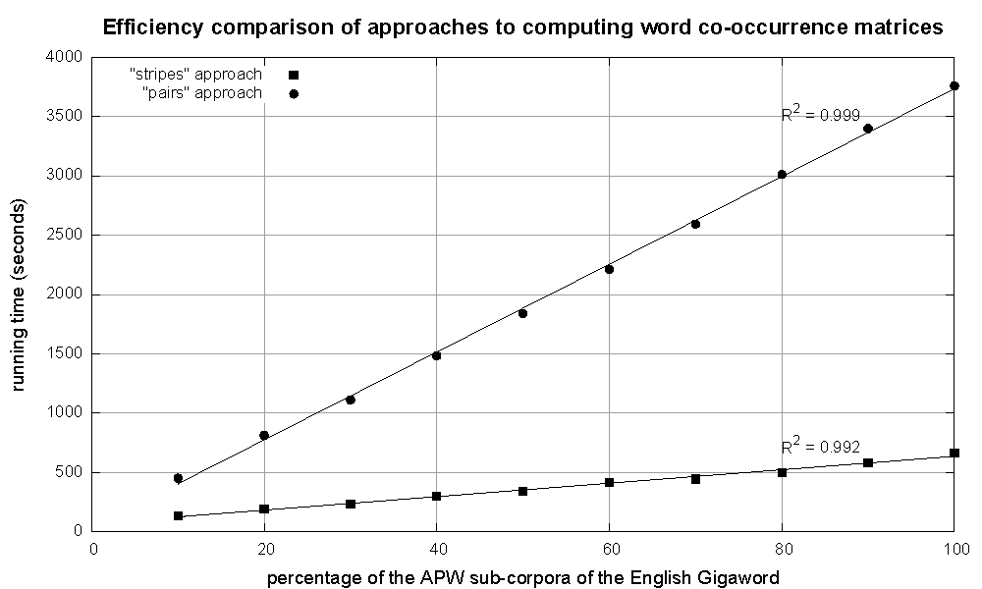
Cluster size: 38 cores
Data Source: Associated Press Worldstream (APW) of the English Gigaword Corpus (v3), which contains 2.27 million documents (1.8 GB compressed, 5.7 GB uncompressed)

Slide 75
Conditional Probabilities
How do we estimate conditional probabilities from counts?
Why do we want to do this?
How do we do this with MapReduce?

Slide 76
P(B|A): “Stripes”
Easy!
  One pass to compute (a, *)
  Another pass to directly compute P(B|A)
a → {b₁:3, b₂ :12, b₃ :7, b₄ :1, … }

Slide 77
P(B|A): “Pairs”
For this to work:
  Must emit extra (a, *) for every b_{n} in mapper
  Must make sure all a’s get sent to same reducer (use partitioner)
  Must make sure (a, *) comes first (define sort order)
  Must hold state in reducer across different key-value pairs
(a, *) → 32
Reducer holds this value in memory
(a, b₁) → 3
(a, b₂) → 12
(a, b₃) → 7
(a, b₄) → 1
…
(a, b₁) → 3 / 32
(a, b₂) → 12 / 32
(a, b₃) → 7 / 32
(a, b₄) → 1 / 32
…

Slide 78
Synchronization in Hadoop
Approach 1: turn synchronization into an ordering problem
  Sort keys into correct order of computation
  Partition key space so that each reducer gets the appropriate set of partial results
  Hold state in reducer across multiple key-value pairs to perform computation
  Illustrated by the “pairs” approach
Approach 2: construct data structures that “bring the pieces together”
  Each reducer receives all the data it needs to complete the computation
  Illustrated by the “stripes” approach

Slide 79
Issues and Tradeoffs
Number of key-value pairs
  Object creation overhead
  Time for sorting and shuffling pairs across the network
Size of each key-value pair
  De/serialization overhead
Combiners make a big difference!
  RAM vs. disk vs. network
  Arrange data to maximize opportunities to aggregate partial results

Slide 80
Questions?

Slide 81
Indexing and Retrieval
Why is this different?
Introduction to MapReduce
Graph algorithms
MapReduce algorithm design
Case study: statistical machine translation
Case study: DNA sequence alignment
Concluding thoughts

Slide 82
Abstract IR Architecture
Documents
Query
online
offline
Representation
Function
Representation
Function
Query Representation
Document Representation
Index
Comparison
Function
Hits

Slide 83
MapReduce it?
The indexing problem
  Scalability is critical
  Must be relatively fast, but need not be real time
  Fundamentally a batch operation
  Incremental updates may or may not be important
  For the web, crawling is a challenge in itself
The retrieval problem
  Must have sub-second response time
  For the web, only need relatively few results
Perfect for MapReduce!
Uh… not so good…

Slide 84
Counting Words…
Documents
case folding, tokenization, stopword removal, stemming
Bag of Words
syntax, semantics, word knowledge, etc.
Inverted
Index

Slide 85
Inverted Index: Boolean Retrieval
Doc 1
Doc 2
Doc 3
Doc 4
one fish, two fish
red fish, blue fish
cat in the hat
green eggs and ham
1
2
3
4
blue
1
blue
2
cat
1
cat
3
egg
1
egg
4
fish
1
1
fish
1
2
green
1
green
4
ham
1
ham
4
hat
1
hat
3
one
1
one
1
red
1
red
2
two
1
two
1

Slide 86
Inverted Index: Ranked Retrieval
Doc 1
Doc 2
Doc 3
Doc 4
one fish, two fish
red fish, blue fish
cat in the hat
green eggs and ham
tf
1
2
3
4
df
blue
1
1
blue
1
2,1
cat
1
1
cat
1
3,1
egg
1
1
egg
1
4,1
fish
2
2
2
fish
2
1,2
2,2
green
1
1
green
1
4,1
ham
1
1
ham
1
4,1
hat
1
1
hat
1
3,1
one
1
1
one
1
1,1
red
1
1
red
1
2,1
two
1
1
two
1
1,1

Slide 87
Inverted Index: Positional Information
Doc 1
Doc 2
Doc 3
Doc 4
one fish, two fish
red fish, blue fish
cat in the hat
green eggs and ham
blue
1
2,1
blue
1
2,1,[3]
cat
1
3,1
cat
1
3,1,[1]
egg
1
4,1
egg
1
4,1,[2]
fish
2
1,2
2,2
fish
2
1,2,[2,4]
1,2,[2,4]
green
1
4,1
green
1
4,1,[1]
ham
1
4,1
ham
1
4,1,[3]
hat
1
3,1
hat
1
3,1,[2]
one
1
1,1
one
1
1,1,[1]
red
1
2,1
red
1
2,1,[1]
two
1
1,1
two
1
1,1,[3]

Slide 88
Indexing: Performance Analysis
Fundamentally, a large sorting problem
  Terms usually fit in memory
  Postings usually don’t
How is it done on a single machine?
How can it be done with MapReduce?
First, let’s characterize the problem size:
  Size of vocabulary
  Size of postings

Slide 89
Vocabulary Size: Heaps’ Law
Heaps’ Law: linear in log-log space
Vocabulary size grows unbounded!
M is vocabulary size
T is collection size (number of documents)
k and b are constants
Typically, k is between 30 and 100, b is between 0.4 and 0.6
Notes:
22

Slide 90
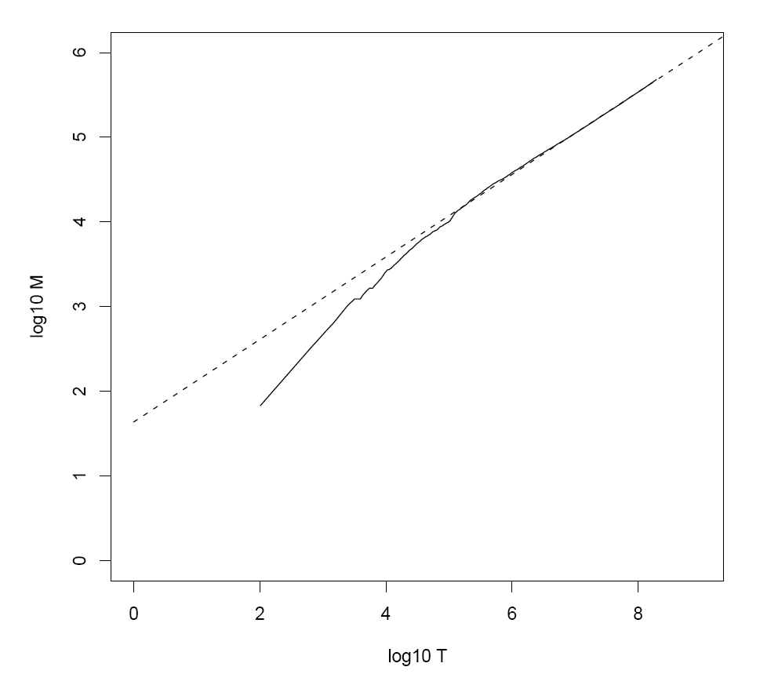
Heaps’ Law for RCV1
k = 44
b = 0.49
First 1,000,020 terms:
Predicted = 38,323
Actual = 38,365
Reuters-RCV1 collection: 806,791 newswire documents (Aug 20, 1996-August 19, 1997)
Manning, Raghavan, Schütze, Introduction to Information Retrieval (2008)

Slide 91
Postings Size: Zipf’s Law
Zipf’s Law: (also) linear in log-log space
  Specific case of Power Law distributions
In other words:
  A few elements occur very frequently
  Many elements occur very infrequently
cf is the collection frequency of i-th common term
c is a constant
Notes:
22

Slide 92
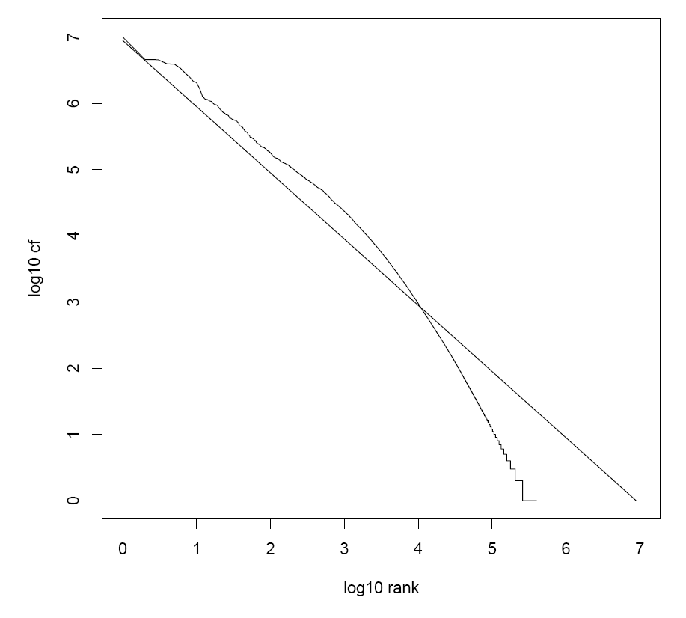
Zipf’s Law for RCV1
Fit isn’t that good… but good enough!
Reuters-RCV1 collection: 806,791 newswire documents (Aug 20, 1996-August 19, 1997)
Manning, Raghavan, Schütze, Introduction to Information Retrieval (2008)

Slide 93
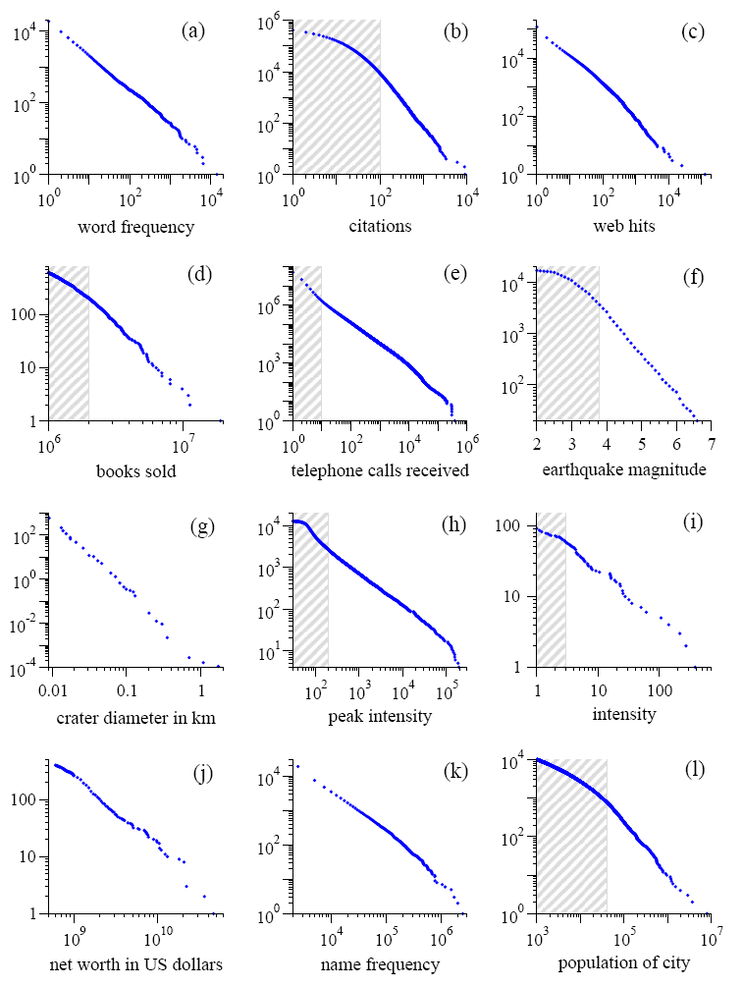
Power Laws are everywhere!
Figure from: Newman, M. E. J. (2005) “Power laws, Pareto distributions and Zipf's law.” Contemporary Physics 46:323–351.

Slide 94
MapReduce: Index Construction
Map over all documents
  Emit term as key, (docno, tf) as value
  Emit other information as necessary (e.g., term position)
Sort/shuffle: group postings by term
Reduce
  Gather and sort the postings (e.g., by docno or tf)
  Write postings to disk
MapReduce does all the heavy lifting!

Slide 95
Inverted Indexing with MapReduce
Doc 1
Doc 2
Doc 3
one fish, two fish
red fish, blue fish
cat in the hat
one
1
1
red
2
1
cat
3
1
Map
two
blue
hat
1
1
2
1
3
1
fish
1
2
fish
2
2
Shuffle and Sort: aggregate values by keys
cat
3
1
Reduce
blue
2
1
fish
1
2
2
2
hat
3
1
one
1
1
two
1
1
red
2
1

Slide 96
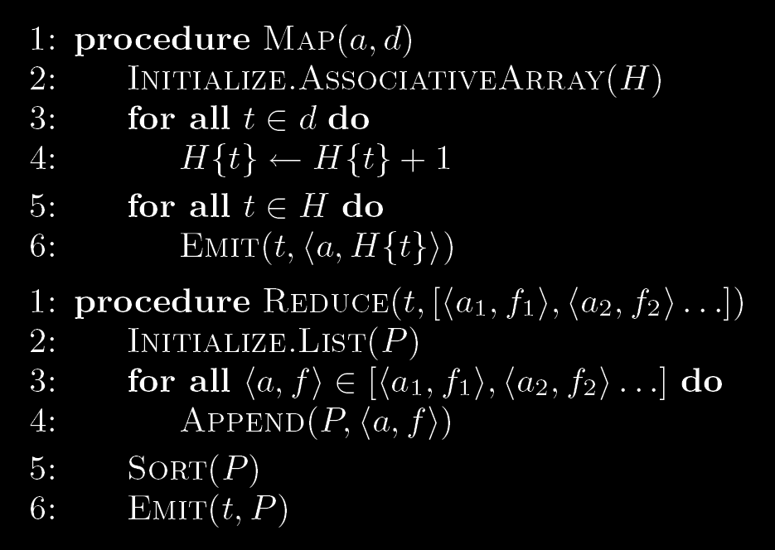
Inverted Indexing: Pseudo-Code

Slide 97
You’ll implement this in the afternoon!

Slide 98
Positional Indexes
Doc 1
Doc 2
Doc 3
one fish, two fish
red fish, blue fish
cat in the hat
one
1
1
[1]
red
2
1
[1]
cat
3
1
[1]
Map
two
blue
hat
1
1
[3]
2
1
[3]
3
1
[2]
fish
1
2
[2,4]
fish
2
2
[2,4]
Shuffle and Sort: aggregate values by keys
cat
3
1
[1]
Reduce
blue
2
1
[3]
fish
1
2
[2,4]
2
2
[2,4]
hat
3
1
[2]
one
1
1
[1]
two
1
1
[3]
red
2
1
[1]

Slide 99
Inverted Indexing: Pseudo-Code
What’s the problem?

Slide 100
Scalability Bottleneck
Initial implementation: terms as keys, postings as values
  Reducers must buffer all postings associated with key (to sort)
  What if we run out of memory to buffer postings?
Uh oh!

Slide 101
Another Try…
(key)
(values)
(keys)
(values)
fish
1
2
[2,4]
fish
1
[2,4]
34
1
[23]
fish
9
[9]
21
3
[1,8,22]
fish
21
[1,8,22]
35
2
[8,41]
fish
34
[23]
80
3
[2,9,76]
fish
35
[8,41]
9
1
[9]
fish
80
[2,9,76]
How is this different?
Let the framework do the sorting
Term frequency implicitly stored
Directly write postings to disk!

Slide 102
Wait, there’s more!
(but first, an aside)

Slide 103
Postings Encoding
Conceptually:
fish
1
2
9
1
21
3
34
1
35
2
80
3
…
In Practice:
Don’t encode docnos, encode gaps (or d-gaps)
But it’s not obvious that this save space…
fish
1
2
8
1
12
3
13
1
1
2
45
3
…

Slide 104
Overview of Index Compression
Non-parameterized
  Unary codes
  γ codes
  δ codes
Parameterized
  Golomb codes (local Bernoulli model)
Want more detail? Read Managing Gigabytes by Witten, Moffat, and Bell!

Slide 105
Unary Codes
x ≥ 1 is coded as x-1 one bits, followed by 1 zero bit
  3 = 110
  4 = 1110
Great for small numbers… horrible for large numbers
  Overly-biased for very small gaps
Watch out! Slightly different definitions in Witten et al., compared to Manning et al. and Croft et al.!

Slide 106
  γ codes
x ≥ 1 is coded in two parts: length and offset
  Start with binary encoded, remove highest-order bit = offset
  Length is number of binary digits, encoded in unary code
  Concatenate length + offset codes
Example: 9 in binary is 1001
  Offset = 001
  Length = 4, in unary code = 1110
  γ code = 1110:001
Analysis
  Offset = ⎣log x⎦
  Length = ⎣log x⎦ +1
  Total = 2 ⎣log x⎦ +1

Slide 107
  δ codes
Similar to γ codes, except that length is encoded in γ code
Example: 9 in binary is 1001
  Offset = 001
  Length = 4, in γ code = 11000
  δ code = 11000:001
γ codes = more compact for smaller numbers
δ codes = more compact for larger numbers

Slide 108
Golomb Codes
x ≥ 1, parameter b:
  q + 1 in unary, where q = ⎣( x - 1 ) / b⎦
  r in binary, where r = x - qb - 1, in ⎣log b⎦ or ⎡log b⎤ bits
Example:
  b = 3, r = 0, 1, 2 (0, 10, 11)
  b = 6, r = 0, 1, 2, 3, 4, 5 (00, 01, 100, 101, 110, 111)
  x = 9, b = 3: q = 2, r = 2, code = 110:11
  x = 9, b = 6: q = 1, r = 2, code = 10:100
Optimal b ≈ 0.69 (N/df)
  Different b for every term!

Slide 109
Comparison of Coding Schemes
 | Unary | γ | δ | Golomb
 |  |  |  | b=3 | b=6
1 | 0 | 0 | 0 | 0:0 | 0:00
2 | 10 | 10:0 | 100:0 | 0:10 | 0:01
3 | 110 | 10:1 | 100:1 | 0:11 | 0:100
4 | 1110 | 110:00 | 101:00 | 10:0 | 0:101
5 | 11110 | 110:01 | 101:01 | 10:10 | 0:110
6 | 111110 | 110:10 | 101:10 | 10:11 | 0:111
7 | 1111110 | 110:11 | 101:11 | 110:0 | 10:00
8 | 11111110 | 1110:000 | 11000:000 | 110:10 | 10:01
9 | 111111110 | 1110:001 | 11000:001 | 110:11 | 10:100
10 | 1111111110 | 1110:010 | 11000:010 | 1110:0 | 10:101
Witten, Moffat, Bell, Managing Gigabytes (1999)

Slide 110
Index Compression: Performance
Comparison of Index Size (bits per pointer)
Bible | TREC
Unary | 262 | 1918
Binary | 15 | 20
γ | 6.51 | 6.63
δ | 6.23 | 6.38
Golomb | 6.09 | 5.84
Recommend best practice
Bible: King James version of the Bible; 31,101 verses (4.3 MB)
TREC: TREC disks 1+2; 741,856 docs (2070 MB)
Witten, Moffat, Bell, Managing Gigabytes (1999)

Slide 111
Chicken and Egg?
(key)
(value)
fish
1
[2,4]
But wait! How do we set the Golomb parameter b?
fish
9
[9]
fish
21
[1,8,22]
Recall: optimal b ≈ 0.69 (N/df)
fish
34
[23]
We need the df to set b…
fish
35
[8,41]
But we don’t know the df until we’ve seen all postings!
fish
80
[2,9,76]
…
Write directly to disk

Slide 112
Getting the df
In the mapper:
  Emit “special” key-value pairs to keep track of df
In the reducer:
  Make sure “special” key-value pairs come first: process them to determine df

Slide 113
Getting the df: Modified Mapper
Doc 1
Input document…
one fish, two fish
(key)
(value)
fish
1
[2,4]
Emit normal key-value pairs…
one
1
[1]
two
1
[3]
fish
★
[1]
Emit “special” key-value pairs to keep track of df…
one
★
[1]
two
★
[1]

Slide 114
Getting the df: Modified Reducer
(key)
(value)
fish
★
[1]
First, compute the df by summing contributions from all “special” key-value pair…
fish
★
[1]
fish
★
[1]
…
Compute Golomb parameter b…
fish
1
[2,4]
fish
9
[9]
fish
21
[1,8,22]
Important: properly define sort order to make sure “special” key-value pairs come first!
fish
34
[23]
fish
35
[8,41]
fish
80
[2,9,76]
…
Write postings directly to disk

Slide 115
MapReduce it?
The indexing problem
  Scalability is paramount
  Must be relatively fast, but need not be real time
  Fundamentally a batch operation
  Incremental updates may or may not be important
  For the web, crawling is a challenge in itself
The retrieval problem
  Must have sub-second response time
  For the web, only need relatively few results
Just covered
Now

Slide 116
Retrieval in a Nutshell
Look up postings lists corresponding to query terms
Traverse postings for each query term
Store partial query-document scores in accumulators
Select top k results to return

Slide 117
Retrieval: Query-At-A-Time
Evaluate documents one query at a time
  Usually, starting from most rare term (often with tf-scored postings)
Tradeoffs
  Early termination heuristics (good)
  Large memory footprint (bad), but filtering heuristics possible
blue
9
2
21
1
35
1
…
Accumulators
(e.g., hash)
Score_{{q=x}}(doc n) = s
fish
1
2
9
1
21
3
34
1
35
2
80
3
…

Slide 118
Retrieval: Document-at-a-Time
Evaluate documents one at a time (score all query terms)
Tradeoffs
  Small memory footprint (good)
  Must read through all postings (bad), but skipping possible
  More disk seeks (bad), but blocking possible
blue
9
2
21
1
35
1
…
fish
1
2
9
1
21
3
34
1
35
2
80
3
…
Accumulators
(e.g. priority queue)
Document score in top k?
Yes: Insert document score, extract-min if queue too large
No: Do nothing

Slide 119
Retrieval with MapReduce?
MapReduce is fundamentally batch-oriented
  Optimized for throughput, not latency
  Startup of mappers and reducers is expensive
MapReduce is not suitable for real-time queries!
  Use separate infrastructure for retrieval…

Slide 120
Important Ideas
Partitioning (for scalability)
Replication (for redundancy)
Caching (for speed)
Routing (for load balancing)
The rest is just details!

Slide 121
Term vs. Document Partitioning
D
T₁
D
T₂
Term
Partitioning
…
T₃
T
Document
Partitioning
…
T
D₁
D₂
D₃

Slide 122
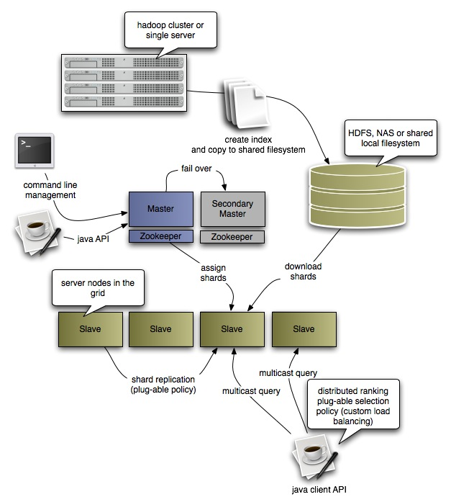
Katta Architecture
(Distributed Lucene)
http://katta.sourceforge.net/

Slide 123
Batch ad hoc Queries
What if you cared about batch query evaluation?
MapReduce can help!

Slide 124
Parallel Queries Algorithm
Assume standard inner-product formulation:
Algorithm sketch:
  Load queries into memory in each mapper
  Map over postings, compute partial term contributions and store in accumulators
  Emit accumulators as intermediate output
  Reducers merge accumulators to compute final document scores
Lin (SIGIR 2009)

Slide 125
Parallel Queries: Map
blue
9
2
21
1
35
1
Mapper
query id = 1, “blue fish”
Compute score contributions for term
key = 1, value = { 9:2, 21:1, 35:1 }
fish
1
2
9
1
21
3
34
1
35
2
80
3
Mapper
query id = 1, “blue fish”
Compute score contributions for term
key = 1, value = { 1:2, 9:1, 21:3, 34:1, 35:2, 80:3 }

Slide 126
Parallel Queries: Reduce
key = 1, value = { 9:2, 21:1, 35:1 }
key = 1, value = { 1:2, 9:1, 21:3, 34:1, 35:2, 80:3 }
Reducer
Element-wise sum of associative arrays
key = 1, value = { 1:2, 9:3, 21:4, 34:1, 35:3, 80:3 }
Sort accumulators to generate final ranking
Query: “blue fish”
doc 21, score=4
doc 2, score=3
doc 35, score=3
doc 80, score=3
doc 1, score=2
doc 34, score=1

Slide 127
A few more details…
Evaluate multiple queries within each mapper
Approximations by accumulator limiting
  Complete independence of mappers makes this problematic
fish
1
2
9
1
21
3
34
1
35
2
80
3
Mapper
query id = 1, “blue fish”
Compute score contributions for term
key = 1, value = { 1:2, 9:1, 21:3, 34:1, 35:2, 80:3 }

Slide 128
Ivory and SMRF
Collaboration between:
  University of Maryland
  Yahoo! Research
Reference implementation for a Web-scale IR toolkit
  Designed around Hadoop from the ground up
  Written specifically for the ClueWeb09 collection
  Implements some of the algorithms described in this tutorial
  Features SMRF query engine based on Markov Random Fields
Open source
  Initial release available now!

Slide 129
Questions?

Slide 130
Case Study:
Statistical Machine Translation
Why is this different?
Introduction to MapReduce
Graph algorithms
MapReduce algorithm design
Indexing and retrieval
Case study: DNA sequence alignment
Concluding thoughts

Slide 131
Statistical Machine Translation
Conceptually simple:
(translation from foreign f into English e)
Difficult in practice!
Phrase-Based Machine Translation (PBMT) :
  Break up source sentence into little pieces (phrases)
  Translate each phrase individually
Dyer et al. (Third ACL Workshop on MT, 2008)

Slide 132
Translation as a “Tiling” Problem
Maria
no
dio
una
bofetada
a
la
bruja
verde
Mary
not
give
a
slap
to
the
witch
green
did not
a slap
by
green witch
no
slap
to the
did not give
to
the
slap
the witch
Example from Koehn (2006)

Slide 133
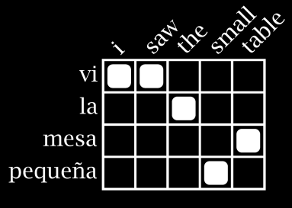
MT Architecture
Training Data
Word Alignment
Phrase Extraction
i saw the small table
(vi, i saw)
(la mesa pequeña, the small table)
…
vi la mesa pequeña
Parallel Sentences
he sat at the table
the service was good
Language
Model
Translation Model
Target-Language Text
Decoder
maria no daba una bofetada a la bruja verde
mary did not slap the green witch
Foreign Input Sentence
English Output Sentence

Slide 134
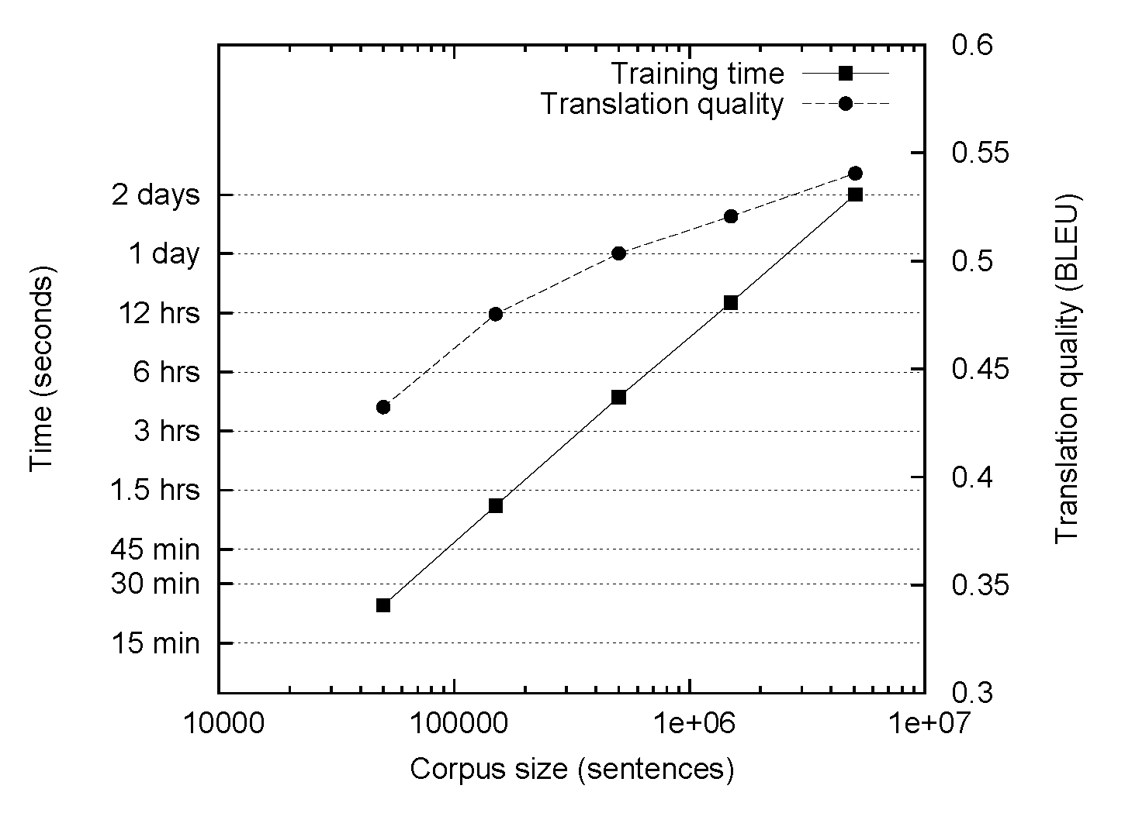
The Data Bottleneck

Slide 135
MT Architecture
There are MapReduce Implementations of these two components!
Training Data
Word Alignment
Phrase Extraction
i saw the small table
(vi, i saw)
(la mesa pequeña, the small table)
…
vi la mesa pequeña
Parallel Sentences
he sat at the table
the service was good
Language
Model
Translation Model
Target-Language Text
Decoder
maria no daba una bofetada a la bruja verde
mary did not slap the green witch
Foreign Input Sentence
English Output Sentence

Slide 136
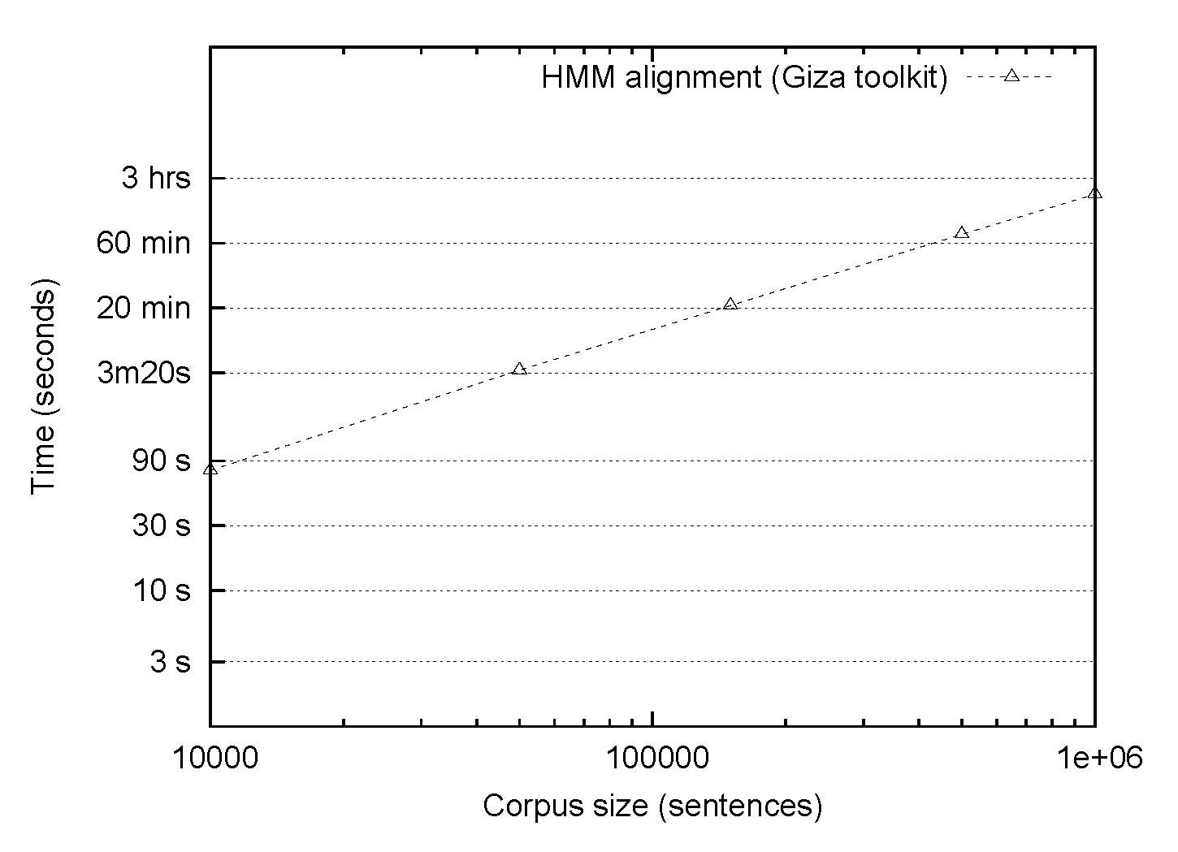
HMM Alignment: Giza
Single-core commodity server

Slide 137
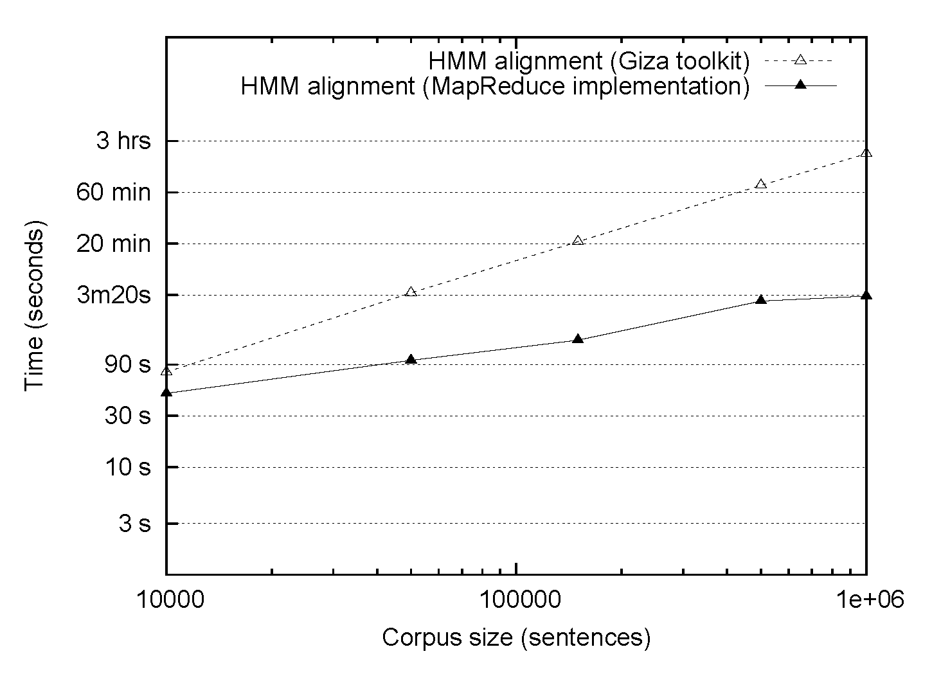
HMM Alignment: MapReduce
Single-core commodity server
38 processor cluster

Slide 138
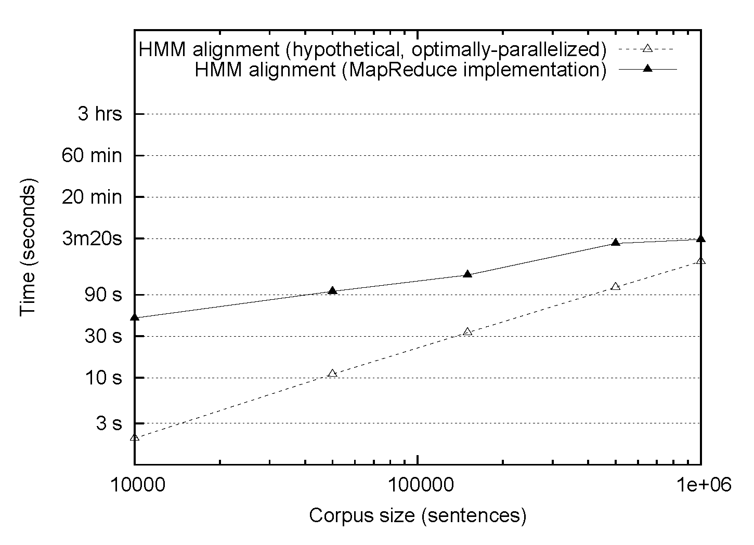
HMM Alignment: MapReduce
38 processor cluster
1/38 Single-core commodity server

Slide 139
MT Architecture
There are MapReduce Implementations of these two components!
Training Data
Word Alignment
Phrase Extraction
i saw the small table
(vi, i saw)
(la mesa pequeña, the small table)
…
vi la mesa pequeña
Parallel Sentences
he sat at the table
the service was good
Language
Model
Translation Model
Target-Language Text
Decoder
maria no daba una bofetada a la bruja verde
mary did not slap the green witch
Foreign Input Sentence
English Output Sentence

Slide 140
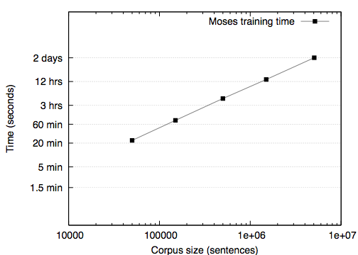
Phrase table construction
Single-core commodity server
Single-core commodity server

Slide 141
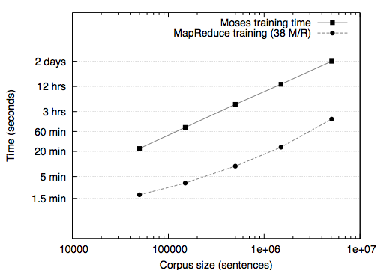
Phrase table construction
Single-core commodity server
Single-core commodity server
38 proc. cluster

Slide 142
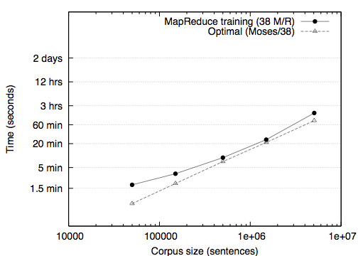
Phrase table construction
Single-core commodity server
38 proc. cluster
1/38 of single-core

Slide 143
What’s the point?
The optimally-parallelized version doesn’t exist!
It’s all about the right level of abstraction

Slide 144
Questions?

Slide 145
Case Study:
DNA Sequence Alignment
Why is this different?
Introduction to MapReduce
Graph algorithms
MapReduce algorithm design
Indexing and retrieval
Case study: statistical machine translation
Concluding thoughts

Slide 146
From Text to DNA Sequences
Text processing: [0-9A-Za-z]+
DNA sequence processing: [ATCG]+
Easier, right?
(Nope, not really)
The following describes the work of Michael Schatz; thanks also to Ben Langmead…

Slide 147
Analogy
(And two disclaimers)

Slide 148
Strangely-Formatted Manuscript
Dickens: A Tale of Two Cities
  Text written on a long spool
It was the best of times, it was the worst of times, it was the age of wisdom, it was the age of foolishness, …
Notes:
Fragment are very short compared to the length of the text
~5 words per fragment uniformly sampling the text
Fragment boundaries from different spools occur at different positions
Compare fragments to each other to find overlapping sequences

Slide 149
… With Duplicates
Dickens: A Tale of Two Cities
  “Backup” on four more copies
It was the best of times, it was the worst of times, it was the age of wisdom, it was the age of foolishness, …
It was the best of times, it was the worst of times, it was the age of wisdom, it was the age of foolishness, …
It was the best of times, it was the worst of times, it was the age of wisdom, it was the age of foolishness, …
It was the best of times, it was the worst of times, it was the age of wisdom, it was the age of foolishness, …
It was the best of times, it was the worst of times, it was the age of wisdom, it was the age of foolishness, …
Notes:
Fragment are very short compared to the length of the text
~5 words per fragment uniformly sampling the text
Fragment boundaries from different spools occur at different positions
Compare fragments to each other to find overlapping sequences

Slide 150
Shredded Book Reconstruction
Dickens accidently shreds the manuscript
How can he reconstruct the text?
  5 copies x 138,656 words / 5 words per fragment = 138k fragments
  The short fragments from every copy are mixed together
  Some fragments are identical
It was the best of
times, it was the worst
of times, it was the
age of wisdom, it was
the age of foolishness, …
It was the best of
It was the best of times, it was the worst of times, it was the age of wisdom, it was the age of foolishness, …
times, it was the worst
of times, it was the
age of wisdom, it was
the age of foolishness, …
It was the best
of times, it was the
worst of times, it was
the age of wisdom, it
was the age of foolishness,
It was the best
of times, it was the
worst of times, it was
the age of wisdom, it
was the age of foolishness,
It was the best of times, it was the worst of times, it was the age of wisdom, it was the age of foolishness, …
It was the
best of times, it was
the worst of times, it
was the age of wisdom,
it was the age of
foolishness, …
It was the
best of times, it was
the worst of times, it
was the age of wisdom,
it was the age of
foolishness, …
It was the best of times, it was the worst of times, it was the age of wisdom, it was the age of foolishness, …
It was
the best of times, it
was the worst of times,
it was the age of
wisdom, it was the age
of foolishness, …
It was
the best of times, it
was the worst of times,
it was the age of
wisdom, it was the age
of foolishness, …
It was the best of times, it was the worst of times, it was the age of wisdom, it was the age of foolishness, …
It
was the best of times,
It was the best of times, it was the worst of times, it was the age of wisdom, it was the age of foolishness, …
It
was the best of times,
it was the worst of
times, it was the age
of wisdom, it was the
age of foolishness, …
it was the worst of
times, it was the age
of wisdom, it was the
age of foolishness, …
Notes:
Fragment are very short compared to the length of the text
~5 words per fragment uniformly sampling the text
Fragment boundaries from different spools occur at different positions
Compare fragments to each other to find overlapping sequences

Slide 151
Overlaps
It was the best of
age of wisdom, it was
It was the best of
4 word overlap
best of times, it was
was the best of times,
it was the age of
it was the age of
It was the best of
1 word overlap
it was the worst of
of times, it was the
of times, it was the
of times, it was the
It was the best of
1 word overlap
of wisdom, it was the
of wisdom, it was the
the age of wisdom, it
the best of times, it
Generally prefer longer overlaps to shorter overlaps
In the presence of error, we might allow the overlapping fragments to differ by a small amount
the worst of times, it
times, it was the age
times, it was the worst
was the age of wisdom,
was the age of foolishness,
was the best of times,
was the worst of times,
wisdom, it was the age
worst of times, it was

Slide 152
Greedy Assembly
It was the best of
age of wisdom, it was
It was the best of
best of times, it was
was the best of times,
it was the age of
the best of times, it
it was the age of
best of times, it was
it was the worst of
of times, it was the
of times, it was the
of times, it was the
of times, it was the
times, it was the worst
of wisdom, it was the
times, it was the age
the age of wisdom, it
the best of times, it
The repeated sequence makes the correct reconstruction ambiguous
the worst of times, it
times, it was the age
times, it was the worst
was the age of wisdom,
was the age of foolishness,
was the best of times,
was the worst of times,
wisdom, it was the age
worst of times, it was

Slide 153
The Real Problem
(The easier version)

Slide 154
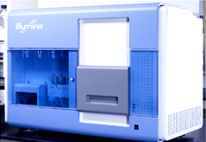
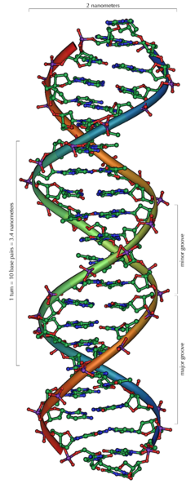
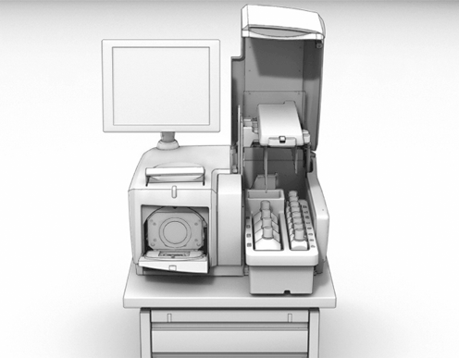
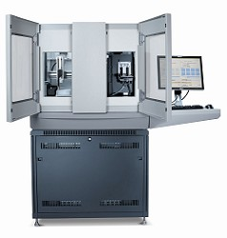
GATGCTTACTATGCGGGCCCC
CGGTCTAATGCTTACTATGC
GCTTACTATGCGGGCCCCTT
?
AATGCTTACTATGCGGGCCCCTT
TAATGCTTACTATGC
AATGCTTAGCTATGCGGGC
AATGCTTACTATGCGGGCCCCTT
AATGCTTACTATGCGGGCCCCTT
CGGTCTAGATGCTTACTATGC
AATGCTTACTATGCGGGCCCCTT
CGGTCTAATGCTTAGCTATGC
ATGCTTACTATGCGGGCCCCTT
Reads
Subject genome
Sequencer

Slide 155
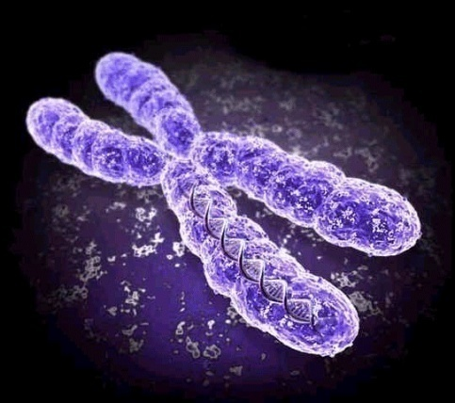
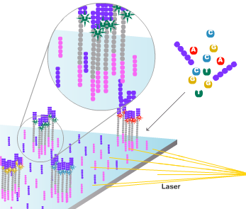
DNA Sequencing
Genome of an organism encodes genetic information in long sequence of 4 DNA nucleotides: ATCG
  Bacteria: ~5 million bp
  Humans: ~3 billion bp
Current DNA sequencing machines can generate 1-2 Gbp of sequence per day, in millions of short reads (25-300bp)
  Shorter reads, but much higher throughput
  Per-base error rate estimated at 1-2%
Recent studies of entire human genomes have used 3.3 - 4.0 billion 36bp reads
  ~144 GB of compressed sequence data
ATCTGATAAGTCCCAGGACTTCAGT
GCAAGGCAAACCCGAGCCCAGTTT
TCCAGTTCTAGAGTTTCACATGATC
GGAGTTAGTAAAAGTCCACATTGAG

Slide 156

How do we put humpty dumpty back together?

Slide 157

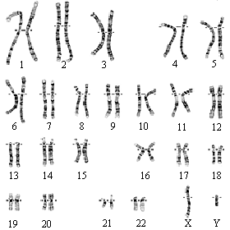
Human Genome
A complete human DNA sequence was published in 2003, marking the end of the Human Genome Project
  11 years, cost $3 billion… your tax dollars at work!

Slide 158
Subject reads
CTATGCGGGC
CTAGATGCTT
A T CTATGCGG
TCTAGATGCT
GCTTA T CTAT
A T CTATGCGG
A T CTATGCGG
A T CTATGCGG
TTA T CTATGC
GCTTA T CTAT
CTATGCGGGC
Alignment
CGGTCTAGATGCTTAGCTATGCGGGCCCCTT
Reference sequence

Slide 159
Subject reads
ATGCGGGCCC
CTAGATGCTT
CTATGCGGGC
TCTAGATGCT
ATCTATGCGG
CGGTCTAG
ATCTATGCGG
CTT
CGGTCT
TTATCTATGC
CCTT
CGGTC
GCTTATCTAT
GCCCCTT
CGG
GCTTATCTAT
GGCCCCTT
CGGTCTAGATGCTTATCTATGCGGGCCCCTT
Reference sequence

Slide 160
Reference: ATGAACCACGAACACTTTTTTGGCAACGATTTAT…
Query: ATGAACAAAGAACACTTTTTTGGCCACGATTTAT…
Insertion
Deletion
Mutation

Slide 161
CloudBurst
  Map: Catalog K-mers
    Emit every k-mer in the genome and non-overlapping k-mers in the reads
    Non-overlapping k-mers sufficient to guarantee an alignment will be found
  2. Shuffle: Coalesce Seeds
    Hadoop internal shuffle groups together k-mers shared by the reads and the reference
    Conceptually build a hash table of k-mers and their occurrences
  3. Reduce: End-to-end alignment
    Locally extend alignment beyond seeds by computing “match distance”
    If read aligns end-to-end, record the alignment
Map
shuffle
Reduce
Human chromosome 1
…
Read 1, Chromosome 1, 12345-12365
Read 1
Read 2
…
Read 2, Chromosome 1, 12350-12370

Slide 162
Results from a small, 24-core cluster, with different number of mismatches
Michael Schatz. CloudBurst: Highly Sensitive Read Mapping with MapReduce. Bioinformatics, 2009, in press.

Slide 163
CloudBurst running times for mapping 7M reads to human chromosome 22 with at most 4 mismatches on EC2
Michael Schatz. CloudBurst: Highly Sensitive Read Mapping with MapReduce. Bioinformatics, 2009, in press.

Slide 164
Wait, no reference?

Slide 165
de Bruijn Graph Construction
D_{k} = (V,E)
  V = All length-k subfragments (k > l)
  E = Directed edges between consecutive subfragments
  Nodes overlap by k-1 words
Locally constructed graph reveals the global sequence structure
  Overlaps implicitly computed
Original Fragment
Directed Edge
It was the best of
It was the best
was the best of
(de Bruijn, 1946; Idury and Waterman, 1995; Pevzner, Tang, Waterman, 2001)

Slide 166
de Bruijn Graph Assembly
It was the best
was the best of
it was the worst
the best of times,
was the worst of
best of times, it
of times, it was
the worst of times,
times, it was the
worst of times, it
it was the age
the age of foolishness
was the age of
the age of wisdom,
age of wisdom, it
of wisdom, it was
wisdom, it was the

Slide 167
Compressed de Bruijn Graph
It was the best of times, it
Unambiguous non-branching paths replaced by single nodes
An Eulerian traversal of the graph spells a compatible reconstruction of the original text
  There may be many traversals of the graph
Different sequences can have the same string graph
  It was the best of times, it was the worst of times, it was the worst of times, it was the age of wisdom, it was the age of foolishness, …
it was the worst of times, it
of times, it was the
the age of foolishness
it was the age of
the age of wisdom, it was the

Slide 168
Questions?

Slide 169
Concluding Thoughts
Why is this different?
Introduction to MapReduce
Graph algorithms
MapReduce algorithm design
Indexing and retrieval
Case study: statistical machine translation
Case study: DNA sequence alignment

Slide 170
When is MapReduce appropriate?
Lots of input data
  (e.g., compute statistics over large amounts of text)
  Take advantage of distributed storage, data locality, aggregate disk throughput
Lots of intermediate data
  (e.g., postings)
  Take advantage of sorting/shuffling, fault tolerance
Lots of output data
  (e.g., web crawls)
  Avoid contention for shared resources
Relatively little synchronization is necessary

Slide 171
When is MapReduce less appropriate?
Data fits in memory
Large amounts of shared data is necessary
Fine-grained synchronization is needed
Individual operations are processor-intensive

Slide 172
Alternatives to Hadoop
 | Pthreads | Open MPI | Hadoop
Programming model | shared memory | message-passing | MapReduce
Job scheduling | none | with PBS | limited
Synchronization | fine only | any | coarse only
Distributed storage | no | no | yes
Fault tolerance | no | no | yes
Shared memory | yes | limited (MPI-2) | no
Scale | dozens of threads | 10k+ of cores | 10k+ cores

Slide 173
cheap commodity clusters
(or utility computing)
+ simple distributed programming models
+ availability of large datasets
= data-intensive IR research for the masses!

Slide 174
What’s next?
Web-scale text processing: luxury → necessity
  Don’t get dismissed as working on “toy problems”!
  Fortunately, cluster computing is being commoditized
It’s all about the right level of abstractions:
  MapReduce is only the beginning…

Slide 175
Applications
(NLP, IR, ML, etc.)
Programming Models
(MapReduce…)
Systems
(architecture, network, etc.)

Slide 176







Questions?
Comments?
Thanks to the organizations who support our work:

Slide 177
Topics: Afternoon Session
Hadoop “Hello World”
Running Hadoop in “standalone” mode
Running Hadoop in distributed mode
Running Hadoop on EC2
Hadoop “nuts and bolts”
Hadoop ecosystem tour
Exercises and “office hours”

Slide 178

Source: Wikipedia “Japanese rock garden”

Slide 179
Hadoop Zen
Thinking at scale comes with a steep learning curve
Don’t get frustrated (take a deep breath)…
  Remember this when you experience those W$*#T@F! moments
Hadoop is an immature platform…
  Bugs, stability issues, even lost data
  To upgrade or not to upgrade (damned either way)?
  Poor documentation (read the fine code)
But… here lies the path to data nirvana

Slide 180
Cloud⁹
Set of libraries originally developed for teaching MapReduce at the University of Maryland
  Demos, exercises, etc.
“Eat you own dog food”
  Actively used for a variety of research projects

Slide 181
Hadoop “Hello World”

Slide 182
Hadoop in “standalone” mode

Slide 183
Hadoop in distributed mode

Slide 184
Hadoop Cluster Architecture
Job submission node
HDFS master
Client
JobTracker
NameNode
TaskTracker
DataNode
TaskTracker
DataNode
TaskTracker
DataNode
Slave node
Slave node
Slave node

Slide 185

Hadoop Development Cycle
1. Scp data to cluster
2. Move data into HDFS
3. Develop code locally
4. Submit MapReduce job
4a. Go back to Step 3
Hadoop Cluster
You
5. Move data out of HDFS
6. Scp data from cluster

Slide 186
Hadoop on EC2

Slide 187
On Amazon: With EC2
0. Allocate Hadoop cluster
1. Scp data to cluster
2. Move data into HDFS
EC2
3. Develop code locally
4. Submit MapReduce job
4a. Go back to Step 3
You
Your Hadoop Cluster
5. Move data out of HDFS
6. Scp data from cluster
7. Clean up!
Uh oh. Where did the data go?

Slide 188
On Amazon: EC2 and S3
Copy from S3 to HDFS
EC2
(Compute Facility)
S3
(Persistent Store)
Your Hadoop Cluster
Copy from HFDS to S3

Slide 189
Hadoop “nuts and bolts”

Slide 190
What version should I use?

Slide 191
Slide from Cloudera basic training

Slide 192
Slide from Cloudera basic training

Slide 193
Slide from Cloudera basic training

Slide 194
Data Types in Hadoop
Writable
Defines a de/serialization protocol. Every data type in Hadoop is a Writable.
WritableComprable
Defines a sort order. All keys must be of this type (but not values).
IntWritable
LongWritable
Text
…
Concrete classes for different data types.

Slide 195
Complex Data Types in Hadoop
How do you implement complex data types?
The easiest way:
  Encoded it as Text, e.g., (a, b) = “a:b”
  Use regular expressions (or manipulate strings directly) to parse and extract data
  Works, but pretty hack-ish
The hard way:
  Define a custom implementation of WritableComprable
  Must implement: readFields, write, compareTo
  Computationally efficient, but slow for rapid prototyping
Alternatives:
  Cloud⁹ offers two other choices: Tuple and JSON

Slide 196
Hadoop Ecosystem Tour

Slide 197
Hadoop Ecosystem
Vibrant open-source community growing around Hadoop
Can I do foo with hadoop?
  Most likely, someone’s already thought of it
  … and started an open-source project around it
Beware of toys!

Slide 198
Starting Points…
Hadoop streaming
HDFS/FUSE
EC2/S3/EMR/EBS

Slide 199
Pig and Hive
Pig: high-level scripting language on top of Hadoop
  Open source; developed by Yahoo
  Pig “compiles down” to MapReduce jobs
Hive: a data warehousing application for Hadoop
  Open source; developed by Facebook
  Provides SQL-like interface for querying petabyte-scale datasets

Slide 200
It’s all about data flows!
M
R
MapReduce
What if you need…
M
M
R
M
Join, Union
Split
Chains
… and filter, projection, aggregates, sorting, distinct, etc.
Pig Slides adapted from Olston et al. (SIGMOD 2008)

Slide 201
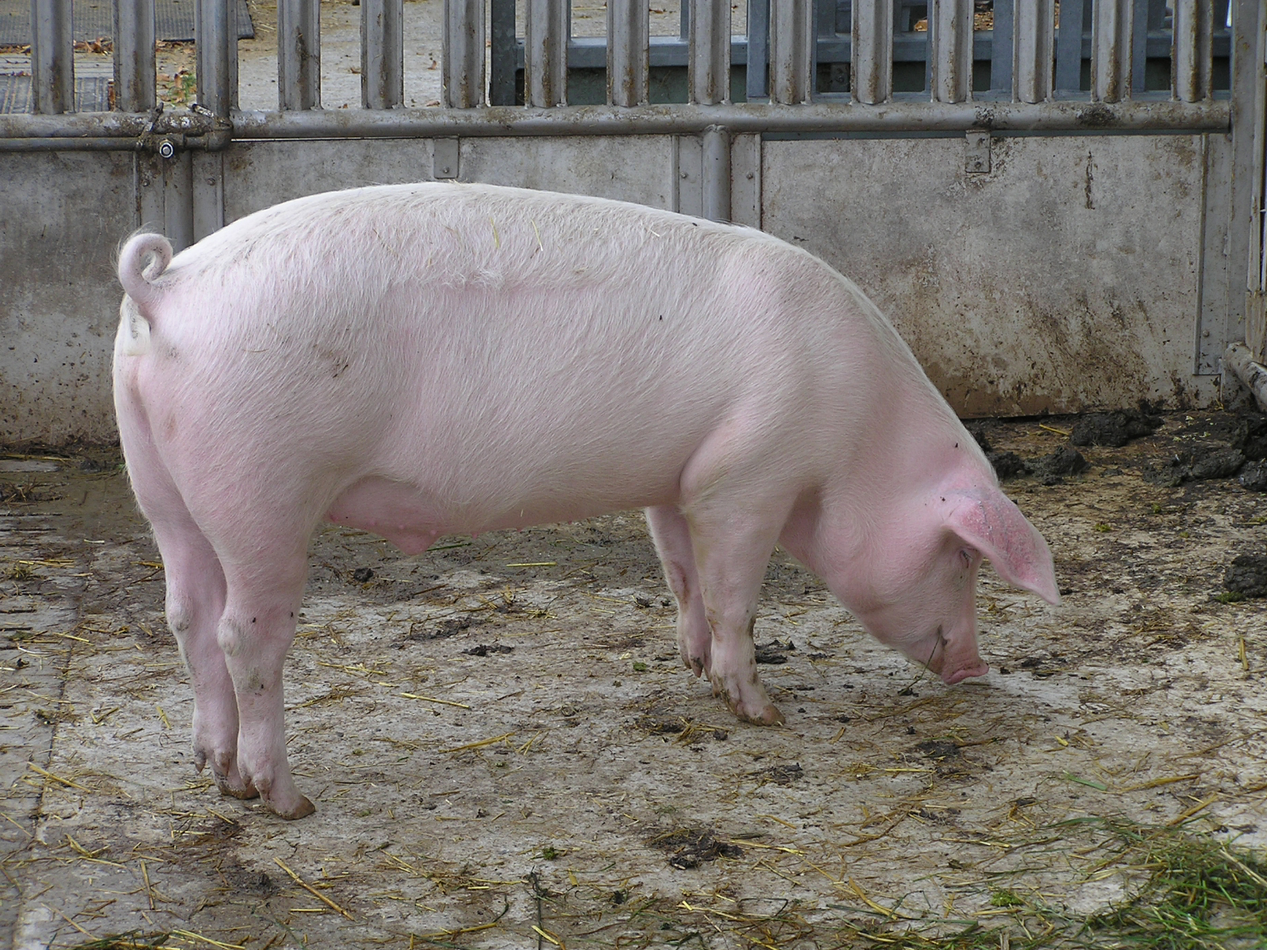

Source: Wikipedia

Slide 202
Example: Find the top 10 most visited pages in each category
Visits
Url Info
User | Url | Time
Amy | cnn.com | 8:00
Amy | bbc.com | 10:00
Amy | flickr.com | 10:05
Fred | cnn.com | 12:00
Url | Category | PageRank
cnn.com | News | 0.9
bbc.com | News | 0.8
flickr.com | Photos | 0.7
espn.com | Sports | 0.9
Pig Slides adapted from Olston et al. (SIGMOD 2008)

Slide 203
Load Visits
Group by url
Foreach url
generate count
Load Url Info
Join on url
Group by category
Foreach category
generate top10(urls)
Pig Slides adapted from Olston et al. (SIGMOD 2008)

Slide 204
visits = load ‘/data/visits’ as (user, url, time);
gVisits = group visits by url;
visitCounts = foreach gVisits generate url, count(visits);
urlInfo = load ‘/data/urlInfo’ as (url, category, pRank);
visitCounts = join visitCounts by url, urlInfo by url;
gCategories = group visitCounts by category;
topUrls = foreach gCategories generate top(visitCounts,10);
store topUrls into ‘/data/topUrls’;
Pig Slides adapted from Olston et al. (SIGMOD 2008)

Slide 205
Map₁
Load Visits
Group by url
Reduce₁
Map₂
Foreach url
generate count
Load Url Info
Join on url
Reduce₂
Map₃
Group by category
Reduce₃
Foreach category
generate top10(urls)
Pig Slides adapted from Olston et al. (SIGMOD 2008)

Slide 206
Other Systems
Zookeeper
HBase
Mahout
Hamma
Cassandra
Dryad
…

Slide 207
Questions?
Comments?
Thanks to the organizations who support our work:

